Slide 1

A+ Guide to Hardware:
Managing, Maintaining, and Troubleshooting, 5e
Chapter 2
Form Factors, Power Supplies, and Working Inside a Computer
A+ Guide to Hardware modified by Dr. Feda AlShahwan

Slide 2
Objectives
Learn about different form factors used for computer cases, motherboards, and power supplies
Learn how electricity is measured and about electrical components
Learn how to select a power supply
Learn how to protect yourself and your equipment against the dangers of electricity
Learn how to work inside a computer case
Learn how to troubleshoot electrical problems
A+ Guide to Hardware modified by Dr. Feda AlShahwan

Slide 3
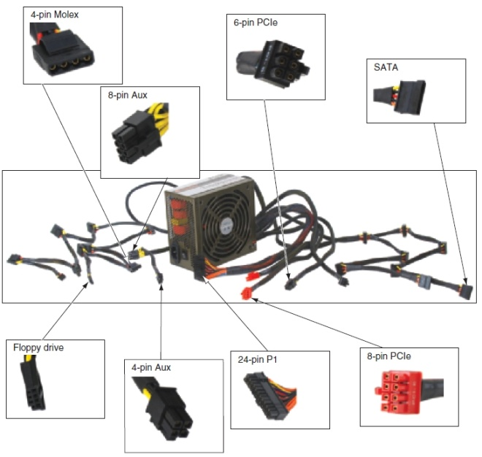
Form Factors Used By Computer Cases, Motherboards, and Power Supplies
Computer case, motherboard, power supply
  Interconnected system
  Must be compatible
Figure 2-1 Computer power supply with connectors
Courtesy: Course Technology/Cengage Learning
A+ Guide to Hardware modified by Dr. Feda AlShahwan

Slide 4
Form Factors Used By Computer Cases, Motherboards, and Power Supplies
Form factor
  Refers to the physical dimensions that specifies size, shape, and features of a device
    Determined by motherboard
Using the same form factor ( PSU, motherboard and case) assures
  Motherboard fits the case
  Powers supply cords provide proper voltage
  Motherboard and case holes align properly
  Case and motherboard ports align
  Wires on case match connections on motherboard
  Power supply holes align with case
A+ Guide to Hardware modified by Dr. Feda AlShahwan

Slide 5
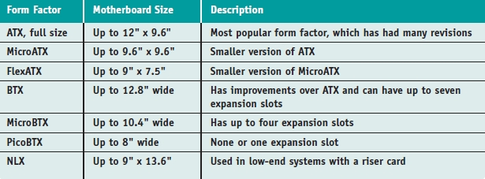
Types of Form Factors
Intended use
  Influences computer case, motherboard, power supply selection (form factor)
Table 2-1 Form factors
A+ Guide to Hardware modified by Dr. Feda AlShahwan

Slide 6
Types of Form Factors (cont’d.)
AT form factor
  P8/P9 connector to supply electrical requirements to the motherboard
ATX form factor
  Most common
  Three major differences
    Main power connector is now a 20-pin keyed
    Cooling fan pours cool air over the motherboard
    Additional connectors supply voltage for drives (+3.3v)
  Motherboard dimensions: up to 12” x 9.6”
A+ Guide to Hardware modified by Dr. Feda AlShahwan

Slide 7
Types of Form Factors (cont’d.)
  Versions
    Original ATX form factor used P1 connector
    ATX Version 2.1 specifications added 2-pin auxiliary connector
    ATX Version 2.2 allowed for 22-pin P1 connector
    Version 2.2 provides +12 volts, +5 volts, and +3.3 volts pins
  Motherboard offers soft switch feature
A+ Guide to Hardware modified by Dr. Feda AlShahwan

Slide 8
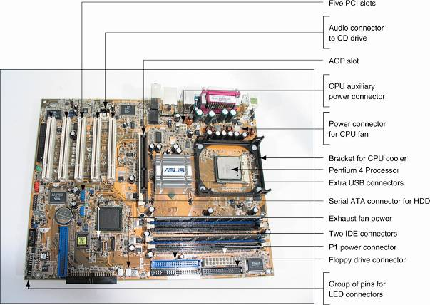
Figure 2-2 The CPU on an ATX motherboard sits opposite the expansion slots and does not block the room needed for long expansion cards
Courtesy: Course Technology/Cengage Learning
A+ Guide to Hardware modified by Dr. Feda AlShahwan

Slide 9
Types of Form Factors (cont’d.)
MicroATX form factor
  Reduces total cost of a system
FlexATX
  Variation of MicroATX with maximum flexibility
BTX (Balanced Technology Extended) form factor
  Reduces heat with better airflow
NLX form factor
  Developed to improve older and similar LPX form factor
A+ Guide to Hardware modified by Dr. Feda AlShahwan

Slide 10
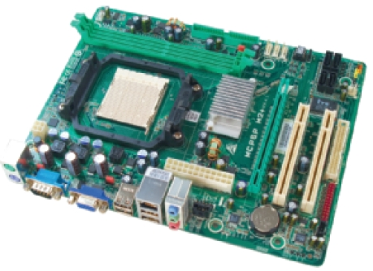
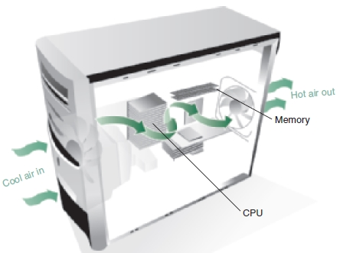
Figure 2-7 This MicroATX motherboard by Biostar is designed to support an AMD processor
Courtesy: Course Technology/Cengage Learning
Figure 2-8 Improved airflow in a BTX case and motherboard makes it unnecessary to have a fan on top of the processor
Courtesy: Course Technology/Cengage Learning
A+ Guide to Hardware modified by Dr. Feda AlShahwan

Slide 11
Types of Computer Cases
Computer case (chassis)
  Houses power supply, motherboard, cards, drives
  Panel switches/lights to control/monitor PC
  Ports connecting cables to motherboard
    Mounted on front, top, side, rear
  Match power supply to system electrical needs
A+ Guide to Hardware modified by Dr. Feda AlShahwan

Slide 12
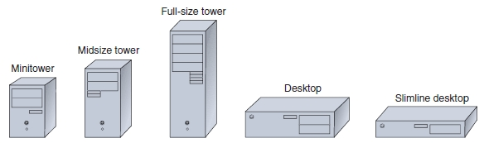
Types of Computer Cases (cont’d.)
Desktop cases
  Motherboard on bottom; power supply to the rear
Tower cases
  Up to 2 feet high; can contain several drives
Notebook cases
  Used for all portables; includes desktop components
Figure 2-11 Tower and desktop cases
Courtesy: Course Technology/Cengage Learning
A+ Guide to Hardware modified by Dr. Feda AlShahwan

Slide 13
Measures and Properties of Electricity
Successful PC technicians:
  Understand electricity
  Know how to use electricity
  Know how to measure electricity
  Can protect computer equipment from electricity
Units used to measure characteristics of electricity
  Volt, amp, ohm, watt
A+ Guide to Hardware modified by Dr. Feda AlShahwan

Slide 14
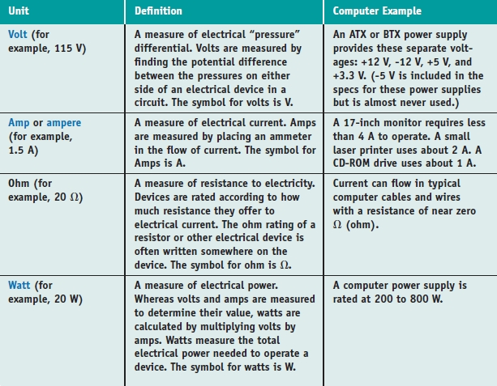
Table 2-3 Measures of electricity
A+ Guide to Hardware modified by Dr. Feda AlShahwan

Slide 15
AC and DC
Alternating current (AC)
  Oscillatory current driven by an alternating voltage
    Example: house current oscillates at 60 Hz
Direct current (DC)
  Single direction current driven by constant voltage
    Required by computer in small amounts, such as 5 V
Power supply acts as a transformer and rectifier
  Rectifier: converts AC to DC
  Transformer: changes ratio of current to voltage
A+ Guide to Hardware modified by Dr. Feda AlShahwan

Slide 16
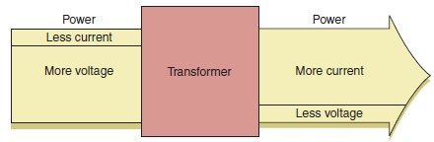
Figure 2-14 A transformer keeps power constant but changes the ratio of current to voltage
Courtesy: Course Technology/Cengage Learning
A+ Guide to Hardware modified by Dr. Feda AlShahwan

Slide 17
Hot, Neutral, and Ground
Completing a circuit:
  AC travels from power station to house on a hot line
  AC travels from panel to device using black (hot) wire
  AC flows out of device circuit in a white (neutral) wire
  AC returns to power station on a neutral line
Short circuit: failure due to excess flow of electricity
  Fuses protect circuits by melting wire (breaking circuit)
  Grounded neutral lines pass detoured AC to earth
Lines in three-prong plugs: hot, neutral, ground
  Receptacle tester verifies outlet wiring
A+ Guide to Hardware modified by Dr. Feda AlShahwan

Slide 18
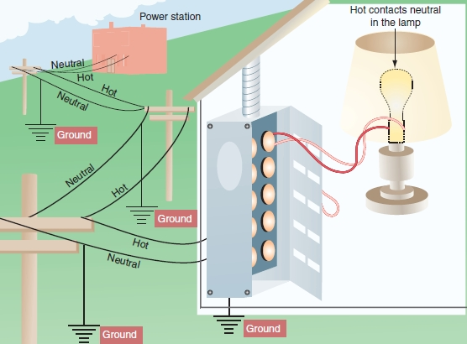
Figure 2-15 Normally, electricity flows from hot to neutral to make a closed circuit in the controlled environment of an electrical device such as a lamp
Courtesy: Course Technology/Cengage Learning
A+ Guide to Hardware modified by Dr. Feda AlShahwan

Slide 19
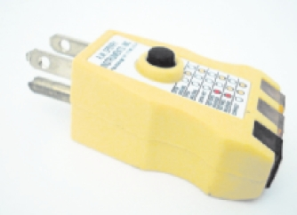
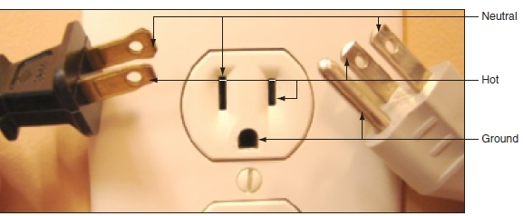
Figure 2-16 A polarized plug showing hot and neutral, and a three-prong plug showing hot, neutral, and ground
Courtesy: Course Technology/Cengage Learning
Figure 2-17 Use a receptacle tester to verify that hot, neutral, and ground are wired correctly
Courtesy: Course Technology/Cengage Learning
A+ Guide to Hardware modified by Dr. Feda AlShahwan

Slide 20
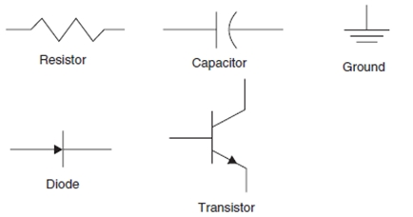
Some Common Electronic Components
Figure 2-18 Symbols for some electronic components and for ground
Courtesy: Course Technology/Cengage Learning
A+ Guide to Hardware modified by Dr. Feda AlShahwan

Slide 21
Some Common Electronic Components
(cont’d.)
Materials to make components:
  Conductors: weakly resist current flow (copper)
  Insulators: highly resist current flow (ceramics)
  Semiconductors: allow flow if charged (silicon)
Transistor
  Switches current on (1) and off (0)
  Amplifies current
  Contains three layers of semiconductor material
  Charge applied to center layer
    Controls switching
A+ Guide to Hardware modified by Dr. Feda AlShahwan

Slide 22
Some Common Electronic Components
(cont’d.)
Capacitor
  Holds electrical charge for a period of time
  Creates even flow of current in a PC
Diode
  Allows electricity to flow in one direction only
  Rectifies current (convert AC to DC)
Resistor
  Controls amount of current flowing through device
  Degree of resistance is measured in ohms
A+ Guide to Hardware modified by Dr. Feda AlShahwan

Slide 23
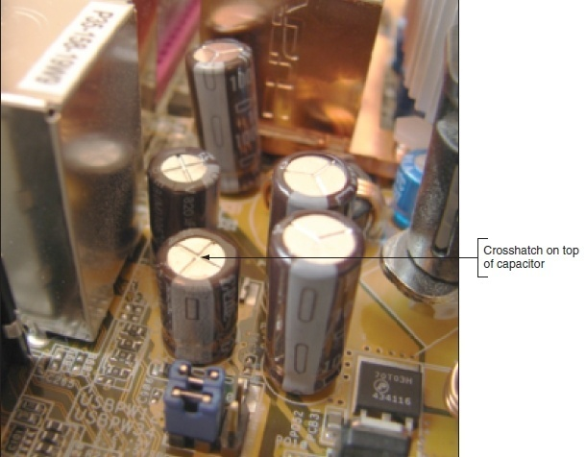
Figure 2-19 Capacitors on a motherboard or other circuit board often have embedded crossed lines on top
Courtesy: Course Technology/Cengage Learning
A+ Guide to Hardware modified by Dr. Feda AlShahwan

Slide 24
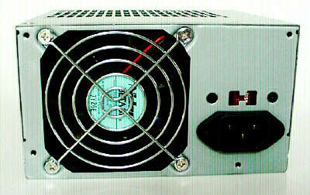
Power Supply
Power supply or power supply unit (PSU)
  Microprocessor → computer's brain and the power supply is its heart
  In a personal computer (PC), the power supply is the metal box usually found in a corner of the case. The power supply is visible from the back of many systems because it contains the power-cord receptacle and the cooling fan
  Box inside a computer case supplying power to motherboard and other installed devices
A+ Guide to Hardware modified by Dr. Feda AlShahwan

Slide 25
Power Supply
The main tasks of power supply
  Both a rectifier and transformer
    Converts AC house current to regulated DC
    Steps down voltage from 110 V or 220 V to 3.5, 5, and 12 V to provide the required voltages and currents that are needed to operate the components of the computer
Power supply features:
  Form factor determines power supply size
  Wattage ratings
    Maximum amount of power watts required by the computer
A+ Guide to Hardware modified by Dr. Feda AlShahwan

Slide 26
Characteristics of Power Supply
    Depends on the components of the computer
    Available PC power-supply ratings are as follows:
      AT clone: 250 watts
    400-watt switching power supply will not necessarily use more power than a 250-watt supply. A larger supply may be needed if you use every available slot on the motherboard or every available drive bay in the personal computer case. It is not a good idea to have a 250-watt supply if you have 250 watts total in devices, since the supply should not be loaded to 100 percent of its capacity
A+ Guide to Hardware modified by Dr. Feda AlShahwan

Slide 27
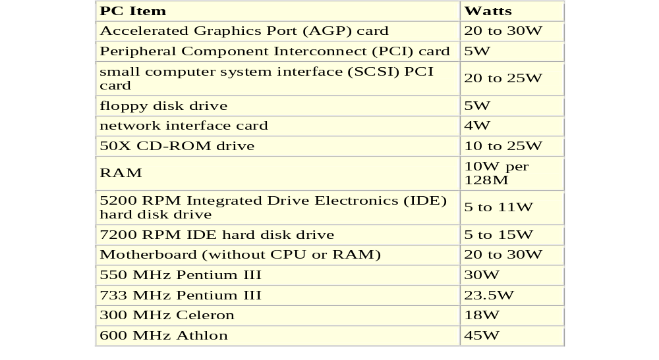
Characteristics of Power Supply
According to PC Power & Cooling, Inc., some power consumption values (in watts) for common items in a personal computer are:
A+ Guide to Hardware modified by Dr. Feda AlShahwan

Slide 28
Characteristics of Power Supply
  AC power voltage
    AC power-line voltages and frequencies vary according to country:
    United States: 120V/60 Hz
    Canada: 120V/60 Hz
    United Kingdom: 240V/50 Hz
    Europe: 220V/50 Hz
    Japan: 100V/50 Hz
  Kuwait: 240V/50 Hz
  Type and number of power cables, and connectors
  Warranty and overall quality
A+ Guide to Hardware modified by Dr. Feda AlShahwan

Slide 29
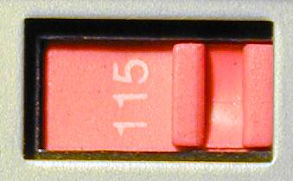
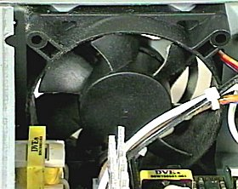
Components of Power Supply
External items of ATX Power Supply
  The AC input socket for the main AC power cord.
  The input voltage selector switch. This switch must be set to match the AC line voltage to which the computer will be connected
  AC output socket for monitor
  The air vents for the cooling fan
A+ Guide to Hardware modified by Dr. Feda AlShahwan

Slide 30
External items of ATX Power Supply (contd)
  The power switch
      Older form factor desktop PC/XT cases had the power switch at the back of the machine, usually on the right side of the case
      Starting with the AT form factor, tower cases changed to a remote, physical toggle power switch that was connected to the power supply using a cable
      Starting with the ATX/NLX form factor, the way the power switch works has been changed altogether. Instead of using a physical toggle switch connected to the power supply, on modern systems the power switch is electronic. It connects to the motherboard, much the way that the reset switch does, using a feature called soft power. So on an ATX system, when you press the power switch, you aren't really turning on the power supply; it is more like sending a "request" to the motherboard to turn the system on
A+ Guide to Hardware modified by Dr. Feda AlShahwan

Slide 31
Components of Power Supply
Internal items of ATX Power Supply
  Power Connectors:
    The types of connectors used on computer power supplies are different. When looking at the ends of each connector we notice that some have flat-blades, some have round pins, and others have square pins.
    There are five types of power connectors:
      Motherboard Connector: The power supply in your computer has one 20-pin connector that supplies power to the motherboard. This style of power connector was introduced as part of the ATX form factor. It is a female 20-pin connector, which plugs into a male connector on your ATX motherboard.
A+ Guide to Hardware modified by Dr. Feda AlShahwan

Slide 32
Components of Power Supply
Internal items of ATX Power Supply (contd.)
      Large 4-pin DC connector (Molex): These large, round-pin type connectors with 4-pins are used for some drives like HDD. The connector is polarized so it can only be installed in one direction
      Medium DC connector (Berg): these medium, square-pin type Connectors with 4-pins are used on some drives like FDD. The connector is polarized so it can only be installed in one direction
      Small DC connector: this small, connector with 2 or 3 pins is sometimes used for the CPU cooler or other devices. Never plug this connector directly into the motherboard
      Auxiliary 12V connector: this is 4-pin square type connector used to provide the motherboard with 12V power
A+ Guide to Hardware modified by Dr. Feda AlShahwan

Slide 33
Troubleshooting Power Supply
Types of Power Supply Problems
Power Up Problems: problems occurred during cold boot up
  Symptom:
    System is completely dead after power-up (no fan noise, LED indicators do not turn on)
  Possible faults:
    AC power cord
    Blown fuse in power supply
  Troubleshooting procedures:
    Check AC power-cord connection: Plug the cord into another power socket (make sure AC wall outlet is good)
    Substitute good power supply
A+ Guide to Hardware modified by Dr. Feda AlShahwan

Slide 34
Troubleshooting Power Supply
  Symptom:
    System shuts off almost immediately or emits a continuous beep or repeating short beeps
  Possible faults:
    New adapter card is overloading the power supply
    Defective adapter card or motherboard
    Defective power supply
  Troubleshooting procedures:
    Remove all adapter cards and check power-supply status after power-up
    If power supply shuts down with only the motherboard connected, substitute good power supply
    Add adapter cards one at a time while checking power-supply status (remember to turn off power when removing or inserting cards)
A+ Guide to Hardware modified by Dr. Feda AlShahwan

Slide 35
Troubleshooting Power Supply
In-Use Problems: problems occurred during working on PC
  Symptom:
    System reboots or shuts down while in use
  Possible faults:
    AC power-line disturbance
    Defective power supply
    Thermal problems; e.g., clogged vent
  Troubleshooting procedures:
    Check AC power line
    Substitute good power supply
A+ Guide to Hardware modified by Dr. Feda AlShahwan

Slide 36
Troubleshooting Power Supply
Cooling the PC:
Cooling Methods
  Includes the methods or components used by the manufacturer for cooling the PC
  Some of the available replacement power supplies have higher-capacity cooling fans than the originals, which can greatly prolong system life and minimize overheating problems—especially for the newer, hotter-running processors. If system noise is a problem, models with special fans can run more quietly than the standard models.
A+ Guide to Hardware modified by Dr. Feda AlShahwan

Slide 37
Troubleshooting Power Supply
  These power supplies often use larger-diameter fans that spin more slowly, so they run more quietly but move the same amount of air as the smaller fans.
  Ventilation in a system is also important. You must ensure adequate airflow to cool the hotter items in the system.
  Heat-sink is a piece of metal usually Aluminum to dissipate the heat generated by the CPU, the larger the surface the better.
A+ Guide to Hardware modified by Dr. Feda AlShahwan

Slide 38
Troubleshooting Power Supply
Cooling Techniques
  Includes the techniques and skills used by the user for cooling the PC
  If you have free expansion slots, you should space out the boards in your system to permit airflow between them.
  Place the hottest running boards nearest the fan or the ventilation holes in the system.
  Always be sure to run your computer with the case cover on, especially if you have a loaded system. With the cover off, the power supply fan no longer draws air through the system. Instead, the fan ends up cooling the supply only, and the rest of the system must be cooled by simple convection.
A+ Guide to Hardware modified by Dr. Feda AlShahwan

Slide 39
Troubleshooting Power Supply
  In addition, be sure that any empty slot positions have the filler brackets installed. If you leave these brackets off after removing a card, the resultant hole in the case disrupts the internal airflow and can cause higher internal temperatures.
A+ Guide to Hardware modified by Dr. Feda AlShahwan

Slide 40
Troubleshooting Power Supply
Repairing Power Supply:
  It is rarely recommended that an inexperienced user open a power supply to make repairs because of the dangerous high voltages present. Even when unplugged, power supplies can retain dangerous voltage and must be discharged (like a monitor) before service.
  Also the price of the power supply is cheap.
  So repairing a power supply is by replacing it.
A+ Guide to Hardware modified by Dr. Feda AlShahwan

Slide 41
How to Select a Power Supply
Considerations
  Match form factor to case, motherboard
  Make sure it provides necessary connectors
  Match wattage capacity to system requirements
  Consider warranty, price, and additional features
Determining wattage capacity
  Consider all components inside case
  Consider USB and FireWire devices
    Get power from ports connected motherboard
A+ Guide to Hardware modified by Dr. Feda AlShahwan

Slide 42
How to Select a Power Supply (cont’d.)
Point to keep in mind
  It may have two ratings
    Room temperature (peak rating)
    Continuous operation (actual rating)
  Video cards draw the most power
  Use power supply rated 30 percent higher than expected
  Web sites have wattage calculators
  Never use Dell power supply with non-Dell motherboard
    Pinout verification or pinout converter
A+ Guide to Hardware modified by Dr. Feda AlShahwan

Slide 43
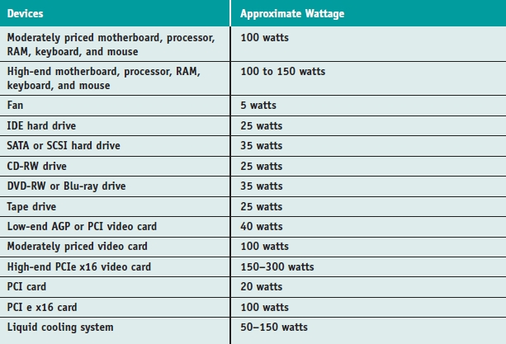
Table 2-5 To calculate power supply rating, add up total wattage
A+ Guide to Hardware modified by Dr. Feda AlShahwan

Slide 44
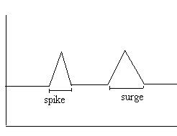
Power Disturbance
Power Disturbances
1. Complete power failure:
  Power-line voltage drops to zero for extended periods of time Consequences: data loss
2. Transients:
  It is an over voltage condition caused by lighting or electric motors resulting in possible permanent system damage
  Classified as:
    Spikes (nanosecond)
    Surges (millisecond)
A+ Guide to Hardware modified by Dr. Feda AlShahwan

Slide 45
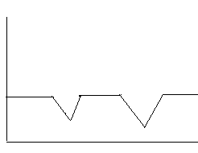
Power Disturbance
3. Sags
  It is an under voltage condition where voltage dips below voltage required by power supply resulting in data loss.
  Classified as:
    Voltage sag (milliseconds)
    Brown out (longer seconds)
Causes of Power-Line Disturbances
Power Company
  Disturbances in power supplied by utility company may be intentional or due to natural causes; e.g., lightning
Sag
Brown out
A+ Guide to Hardware modified by Dr. Feda AlShahwan

Slide 46
Power Disturbance
Building-related
  Power fluctuations may be caused by faulty or inadequate building wiring
  Building machinery; e.g., air conditioners, lighting, heating systems
User wiring
  Multiple PCs plugged into the same power line
  PCs plugged into power line shared by high-current machines; e.g., laser printers, air conditioners, coffee makers, copiers, etc.
  PC plugged into an ungrounded power strip
A+ Guide to Hardware modified by Dr. Feda AlShahwan

Slide 47
Power Disturbance
Solutions to power line disturbances
1. Surge Suppressors
  What is a surge suppressor?
  Power-distribution box that suppresses voltage spikes using a Metal Oxide Varistor (MOV)
  Protects equipment from sudden power changes
  Absorbs and/or blocks surge (AC filter)
  Metal oxide varistor:
    Electrical circuit protection component placed across AC power-line inputs
    Short-circuits high-voltage spikes
    Effectiveness deteriorates with use (over voltage conditions)
A+ Guide to Hardware modified by Dr. Feda AlShahwan

Slide 48
Power Disturbance
Solutions to power line disturbances
Surge Suppressors
Backup Power Supplies
  What is a backup power supply?
  Power supply incorporating a battery and an AC inverter circuit that provides continuous power when line power fails
  Two basic types are available: SPS and UPS
Standby Power Supply (SPS):
  Batteries charged while current level is monitored
  If power fails, batteries switch on automatically
  Faster switch times desirable (5 ms or less)
A+ Guide to Hardware modified by Dr. Feda AlShahwan

Slide 49
Power Disturbance
Uninterruptible power supply (UPS):
  Batteries always used to provide power to system
  Input power used to charge batteries while in use
  More expensive than SPS
AC outlet power
PC input power
Line sensor
Charger
Battery
Switch
Invertor
Figure 2-26: SPS Block Diagram
AC outlet power
Charger
Battery
Invertor
PC input power
Figure 2-27: UPS Block Diagram
A+ Guide to Hardware modified by Dr. Feda AlShahwan

Slide 50
Protect Yourself and the Equipment Against Electrical Dangers
PC support activities present physical dangers
  PC technicians must protect themselves and others
  PC technicians must protect the equipment
A+ Guide to Hardware modified by Dr. Feda AlShahwan

Slide 51
Protect Yourself Against Electrical Shock and Burns
Protection from electrical shock
  Disconnect power
    Pull plug at AC outlet
  Protect power cord
    Do not pull on cord itself
  Remove jewelry
  Power supplies and CRT monitors contain capacitors
    Technician must not be grounded
    Both considered field replaceable unit (FRU)
A+ Guide to Hardware modified by Dr. Feda AlShahwan

Slide 52
Protect the Equipment Against Static Electricity or ESD
Static electricity (electrostatic discharge or ESD)
  Touching device causes discharge, damaging device
  Particularly severe in dry and cold climates
Protecting system from ESD
  Use ground bracelet, static mat, static shielding bags, ESD gloves
  Touch computer case before touching components
  Touch person when passing components
  Remove jewelry, work on hard floors
  Unplugged power cord before working inside case
A+ Guide to Hardware modified by Dr. Feda AlShahwan

Slide 53
Protect Against Electromagnetic Interference
Caused by magnetic fields generated by current flow
RFI (radio frequency interference)
  EMI in radio frequency range affecting reception
Crosstalk problem
  Data in cables crossing EM fields gets corrupted
  Control crosstalk by shielding cables, power supply
Detect EMI using tuned-down AM radio
Other ways to protect device:
  Use line conditioners; shield cables, power supply
  Move PC to a new location
A+ Guide to Hardware modified by Dr. Feda AlShahwan

Slide 54
Surge Protection and Battery Backup
Storms and uneven AC flow cause power surges
  Prevented by installing an AC filter
Devices between AC outlet and computer equipment:
  Power Strips
  Surge suppressors
  Power conditioners
  Uninterruptible power supplies (UPSs)
Use devices with UL (Underwriters Laboratory) logo
  UL 1449
A+ Guide to Hardware modified by Dr. Feda AlShahwan

Slide 55
Surge Protection and Battery Backup (cont’d.)
Surge protector
  Protects equipment from sudden power changes
  Absorbs and/or blocks surge
Recommended features:
  Joules rating greater than 600 joules
  Protection activation time (2 nanoseconds or less)
  Warranty for connected equipment and UL seal
  Light indicating surge protection working
  Data line protector for telephone line to modem
  Let-through voltage rating and line noise filtering
A+ Guide to Hardware modified by Dr. Feda AlShahwan

Slide 56
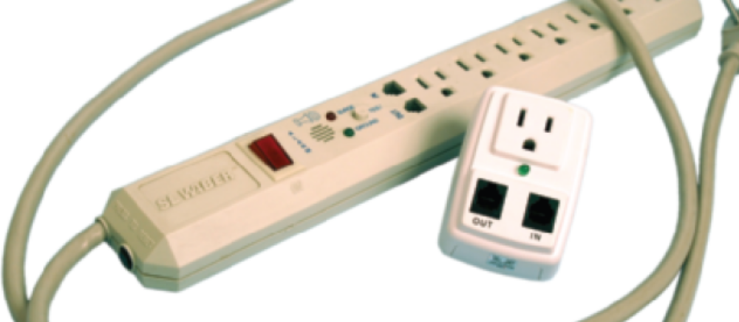
Figure 2-28 Both surge suppressors alert you when protection is not working. The small surge suppressor is designed to travel with a laptop
Courtesy: Course Technology/Cengage Learning
A+ Guide to Hardware modified by Dr. Feda AlShahwan

Slide 57
Surge Protection and Battery Backup (cont’d.)
Line conditioners (power conditioners)
  Protect against spikes or swells (voltage surges)
  Raise voltage during brownouts (voltage sags)
  Filter EMI/RFI interference from the electrical line
Power conditions are measured in watts, volt-amperes (VA), kilovolt-amperes (kVA)
Determining VA needed
  Multiply amperage of each component by 120 V
  Add up the VA for each component
Provide no protection against a total blackout
A+ Guide to Hardware modified by Dr. Feda AlShahwan

Slide 58
Surge Protection and Battery Backup (cont’d.)
Uninterruptible power supply (UPS) benefits
  Conditions line to account for brownouts, spikes
  Provides backup power during a blackout
  Provides protection against very high spikes
Designs: standby, inline, line-interactive
Smart (intelligent) UPS: controlled with software
Considerations when buying
  VA rating and watts
  Degree of line conditioning
  Warranties, guarantees, and service policies
A+ Guide to Hardware modified by Dr. Feda AlShahwan

Slide 59
How to Work Inside a Computer Case
Skills needed to:
  Replace computer parts inside the case
  Build a system from scratch
Requires tools and safety precautions
Taking a PC apart and putting it back together
  Should follow step-by-step procedures
A+ Guide to Hardware modified by Dr. Feda AlShahwan

Slide 60
PC Support Technician Tools
Essential tools
  Ground bracelet, ground mat, ground gloves
  Flat-head screwdriver
  Phillips-head or cross-head screwdriver
  Torx screwdriver set (size T15)
  Insulated tweezers
  Extractor
  OS recovery CD or DVD
Many other non-essential tools exists
Use a toolbox
A+ Guide to Hardware modified by Dr. Feda AlShahwan

Slide 61
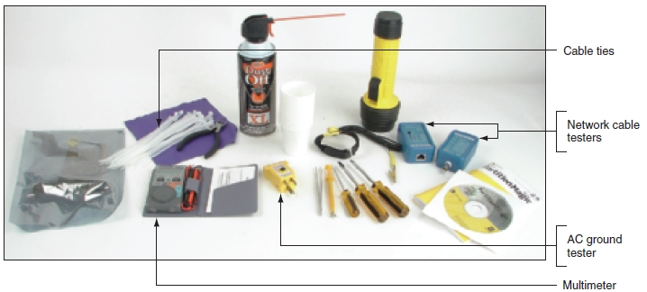
Figure 2-31 PC support technician tools
Courtesy: Course Technology/Cengage Learning
A+ Guide to Hardware modified by Dr. Feda AlShahwan

Slide 62
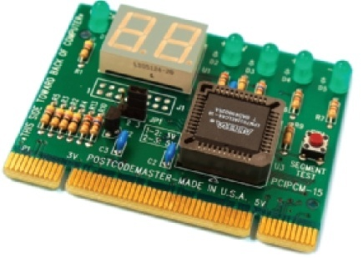
PC Support Technician Tools (cont’d.)
Post Diagnostic Cards
  Helps discover, report computer errors and conflicts at power-on self test (POST)
    Tests performed by startup BIOS
Figure 2-32 Post Code Master diagnostic card by Microsystems Developments, Inc.
Courtesy: Course Technology/Cengage Learning
A+ Guide to Hardware modified by Dr. Feda AlShahwan

Slide 63
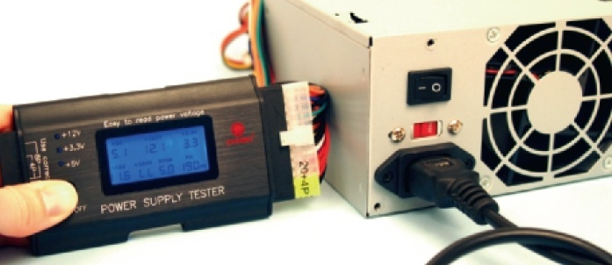
PC Support Technician Tools (cont’d.)
Power Supply Tester
  Measures output of each power supply connector
Figure 2-33 Use a power supply tester to test the output of each power connector on a power supply
Courtesy: Course Technology/Cengage Learning
A+ Guide to Hardware modified by Dr. Feda AlShahwan

Slide 64
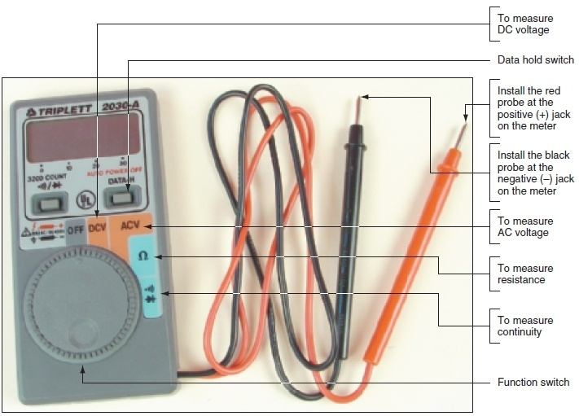
PC Support Technician Tools (cont’d.)
Multimeter
  Measure several characteristics of electricity in a variety of devices
Figure 2-34 This digital multimeter can be set to measure voltage, resistance, or continuity
Courtesy: Course Technology/Cengage Learning
A+ Guide to Hardware modified by Dr. Feda AlShahwan

Slide 65
Safety Precautions
Make notes for backtracking
Stay organized, do not stack boards
Do not touch board chips
  With hands, magnetized screwdriver
Do not change dual inline package (DIP) switch settings with a graphite pencil
Protect yourself and the equipment
  Never ever touch inside of a turned on computer
  Consider monitor, power supply as “black boxes”
  Protect against static electricity
A+ Guide to Hardware modified by Dr. Feda AlShahwan

Slide 66
Steps to Take Apart a Computer
Tools needed
  Ground bracelet, a Phillips-head screwdriver, a flat-head screwdriver, paper, pen
Guidelines
  Back up data
  Power down system, unplug it, press power button
  Put computer on a table with plenty of room
  Open computer case
  Diagram all cable connections
A+ Guide to Hardware modified by Dr. Feda AlShahwan

Slide 67
Steps to Take Apart a Computer (cont’d.)
Guidelines (cont’d.)
  Before removing ribbon cables, look for red color or stripe down one side of each cable
  Remove cables to all drives
  Remove expansion cards
  Remove motherboard
  Remove power supply
  Remove drives
A+ Guide to Hardware modified by Dr. Feda AlShahwan

Slide 68
Steps to Put a Computer Back Together
Reverse disassembly process
Component installation order
  Power supply, drives, motherboard, cards
  Connect all data and power cables
  Plug in keyboard, monitor, mouse
  Turn on power
  Verify PC working properly
A+ Guide to Hardware modified by Dr. Feda AlShahwan

Slide 69
Troubleshooting the Electrical System
Electrical problems can occur before or after boot
  May be consistent or inconsistent
Possible electrical problem symptoms:
  PC appears “dead”
  PC sometimes halts during booting
  Error codes or beeps occur during booting
  Smell burnt parts or odors exists
  PC powers down at unexpected times
  Hear a whine coming from the power supply
Most PC problems have simple solutions
A+ Guide to Hardware modified by Dr. Feda AlShahwan

Slide 70
Problems with External Power
Brownout (reduced current) may create issues
  Check out other devices using same circuit
  Remove other devices
    See if voltage increases
Resolution
  Install line conditioner
    Conditions voltage to the PC
A+ Guide to Hardware modified by Dr. Feda AlShahwan

Slide 71
Problems with Loose Internal Connections
Can cause a system to appear dead or reboot itself
Troubleshooting tasks:
  ATX and BTX power supplies
    Verify power switch wire connected properly to motherboard and turned on before power comes up
  Remove case cover
    Check all power connections
    Check cables linking power supply to motherboard
    Check cables linking power supply to drives
  Verify case front panel in place before power-on
A+ Guide to Hardware modified by Dr. Feda AlShahwan

Slide 72
Problems that Come and Go
Intermittent symptoms indicating a post-boot problem
  Computer stops, hangs, reboots for no reason
  Memory errors appear intermittently
  Data written incorrectly to the hard drive
  Keyboard stops working at odd times
  Motherboard fails or is damaged
  Power supply overheats, becomes hot to the touch
  Power supply fan becomes very noisy or stops
Intermittent problems are more difficult to solve
A+ Guide to Hardware modified by Dr. Feda AlShahwan

Slide 73
Problems with an Inadequate Power Supply
Power supply may not meet needs of new devices
Testing for an adequate power supply
  Make all devices in the system work at the same time
    Example: copy files from new drive to old drive
Simple solution: upgrade to a higher power supply
Calculate total wattage needed by system
A+ Guide to Hardware modified by Dr. Feda AlShahwan

Slide 74
Problems with a Faulty Power Supply
Test with a power supply tester or multimeter
Power supply with correct voltages
  May still be problem source
ATX power supply monitors motherboard voltage range
  Halts motherboard if voltages inadequate
If power supply appears “dead”, replace it
A+ Guide to Hardware modified by Dr. Feda AlShahwan

Slide 75
Problems with the Power Supply Fans
Fans usually hum, whine before failing
  Replace fan or entire power supply
  Suspect another short if failure continues
  Do not operate PC if fan not working
Troubleshooting nonfunctional fan
  Turn off power; remove all power cord connections to all components except motherboard; turn on power
  Turn off power; reconnect one card or drive at a time
  Motherboard power supply problem
    Fan does not work when all devices except motherboard disconnected
A+ Guide to Hardware modified by Dr. Feda AlShahwan

Slide 76
Problems with Overheating
Computer powers down after operating for a few minutes or a few hours
Troubleshooting
  Leave system turned off for about 30 minutes, try again
  Check computer’s internal temperature
  Install additional fans
A+ Guide to Hardware modified by Dr. Feda AlShahwan

Slide 77
Power Problems with the Motherboard
Bad contact between board component and chassis
  Short can seriously damage motherboard
  Check for missing or extra standoffs (spacers)
Shorts in the circuit on motherboard
  Look for damage to the bottom of the motherboard
  Look for burned-out capacitors
A+ Guide to Hardware modified by Dr. Feda AlShahwan

Slide 78
Replacing the Power Supply
Criteria for replacement power supply
  Uses correct form factor
  Adequately rated for power in watts
  Has necessary power connectors
Determining power supply problem
  Turn off PC, open computer case, set new power supply on top of the old one
  Disconnect old power supply’s cords, plug PC devices into the new power supply
  Turn on PC, verify new power supply solves problem
A+ Guide to Hardware modified by Dr. Feda AlShahwan

Slide 79
Summary
Form factor specifies size, shape, features of device
  Motherboard, power supply, and case share the same form factor
Types of cases: desktop, tower, notebook
Quantities characterizing electricity
  Voltage, current, resistance, power
Current flows from hot wires to neutral wires
  Excess current escapes through grounds
A+ Guide to Hardware modified by Dr. Feda AlShahwan

Slide 80
Summary (cont’d.)
AC supplied by power station
  Transformed, rectified before flowing into PC
Major components in a circuit board
  Transistor, capacitor, diode, resistor
Electrical threats
  ESD, EMI, uneven current flow, sudden power surges (or spikes)
A+ Guide to Hardware modified by Dr. Feda AlShahwan

